Slide 1
CS 1B Review Part 1

Slide 2

Topics (1)
Enums
Typedefs
String datatype
Arrays
Cstrings
Multi-dimensional arrays
Binary search
Structures
Casting

Slide 3

Topics (2)
Classes
Class Constructors
Destructors
Helper functions
Information hiding
Array of objects
Static data members
Const parameter

Slide 4
C++ Data Types
simple
structured
integral enum
floating
array struct union class
char short int long bool
address
float double long double
pointer reference

Slide 5

Enumerated Types
Used to increase readability and maintainability
Enumerated types are used to declare a set of integer constants
Syntax:
enum [tag]
{comma separated list of identifiers} [variable-list];

Slide 6

Enumerated Type Example
enum trees
{
oak,
maple,
cherry
};// no variables declared yet
enum trees myTree; // declares a variable of type enum trees
See example: enum1.cpp

Slide 7

Typedefs
Used to associate an identifier with a type (no storage allocated)
Enhances readability and maintainability
Allows programmers to use types that are appropriate to the application
Syntax:
typedef oldType newType

Slide 8

Typedef Example
Example:
typedef int color;
// color is now a type
color red, white, blue
See example: enum1.cpp

Slide 9
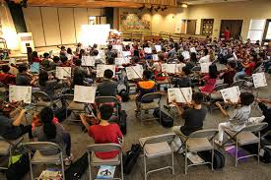
String Class (1)
String class
A class supplied by many compiler vendors
Not part of the language
Need to #include <string>
Cannot always be used (open of files requires a C string)
Using the String class can eliminate many of the problems associated with Cstrings
Has over 100 members

Slide 10
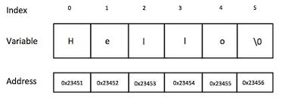
String Class (2)
String class
Memory is dynamically allocated when needed
Many operators are overloaded
+ << >> [ ]
Has a default constructor that initializes a string object to A NULL string
Has another constructor that takes a parameter, creates a string object, and sets it to the parameter
Boundary checking member function available

Slide 11
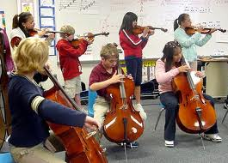
String Class (3)
Can create an array of string variables
String myStrings[30];
myStrings[2] = “Hello World” ; // accesses third string
See examples: string1.cpp through string3.cpp

Slide 12
C++ Data Types
simple
structured
integral enum
floating
array struct union class
char short int long bool
address
float double long double
pointer reference

Slide 13
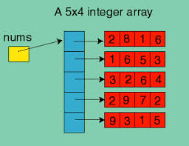
Arrays (1)
Used to store multiple values of the same datatype in one variable name
Stored contiguously in memory
Individual elements can be accessed using a subscript called an index
Syntax:
datatype arrayName [[numberOfCells]];

Slide 14
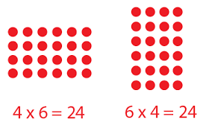
Arrays (2)
Valid indices are 0 through numberOfCells-1
Integers (int, char, bool, short, long, enum, unsigned short, unsigned long, unsigned int) expressions must be used for the index
C++ does not do boundary checking (not a compilation error)
Given the allocation: int testScores[1000]; - cout << testScores[1000] ; returns an unpredictable value
This is a very common problem using loops (for, while, do)

Slide 15
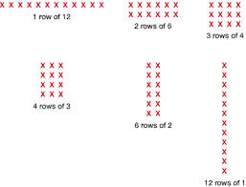
Array Size
Given the following allocation (assuming 32 bit integers)
Int testScores[100];
sizeof(testScores) would be 400
sizeof(testScores[0]) would be 4

Slide 16
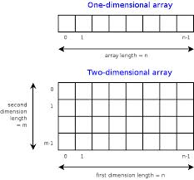
Array Initialization
int testScores[10] = {100,89,99}
elements 3-9 will be initialized to zero
float dollars[ ] = {12.64,3.99,97.82}
# of cells equals the number of initial values
The contents of a cell is unpredictable if not initialized

Slide 17
Array Addresses
Given int arrayName[10]
If arrayName [0] is at address 1000 then arrayName[1] will be at address 1004 (assuming 32 bit integers)
The name of the array without brackets evaluates to the address of the first cell in the array
The name of the array without brackets is a pointer (because its value is an address)
The array name is equivalent to &arrayName[0]
See example: array1.cpp

Slide 18
Aggregate Operations on Arrays
There aren’t any EXCEPT aggregate I/O is permitted for Cstrings (special kinds of char arrays)
See examples: array2.cpp and array3.cpp

Slide 19

Arrays as Parameters to Functions (1)
Arrays can be passed as parameters to functions but in contrast to other variable types, it is not possible to pass a copy of the array
Instead the address of the array name serves as the parameter and the function can access the array elements through the address

Slide 20

Arrays as Parameters to Functions (2)
Functions can change the array elements
The array name is the address of the array (address of the first cell)
Function has no knowledge of the number of elements or type
Generally, functions that work with an entire array require two items of information as arguments:
The beginning memory address of the array (base address)
The number of elements to process in the array

Slide 21
Arrays as Parameters to Functions (3)
To prevent a function from changing an array use the word “const” in the function heading and prototype
See example: array4.cpp

Slide 22
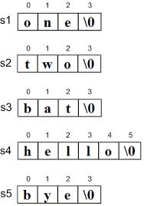
CStrings (1)
Cstrings or character strings
NOT the string class
Is a char array terminated by the null character ‘\0’ ( with ASCII value 0 )
char cstring[10]; - can store 9 characters
A Cstring constant is constant enclosed within double quotes “ABC”

Slide 23
CStrings (2)
A Cstring variable can be initialized in its declaration in two equivalent ways
char helloMessage [ 6 ] = { ‘H’, ‘e’, ‘l’, ‘l’, ‘o’, ‘\0’ };
char helloMessage [ 6 ] = “Hello” ;
char helloMessage [6];
helloMessage = “Hello” // will give a compilation error since one is trying to change the address of the array helloMessage
‘A’ is data type char and is stored in 1 byte
“A” is a C string of 2 characters and is stored in 2 bytes

Slide 24

More on CStrings
Passing CStrings
C++ associates a string constant with the address of the 1st character
myFunction("I am here"); address of I is passed to myFunction
Concept of strings related to character arrays (stored in contiguous memory locations)
BIG difference - strings end with a NULL while a character array may or may not

Slide 25

Even More on CStrings
Aggregate C String I/O in C++
I/O of an entire C string is possible using the array identifier with no subscripts and no looping (like the %s in C)
This cannot be done with any other data type (a loop is required to input an integer array)
cout expects a NULL in the array
It will send characters to the output stream until it finds one

Slide 26
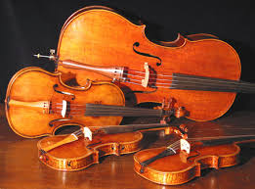
More on Cstring I/O (1)
When using the extraction operator (>>) to read input characters into a Cstring variable, the >> operator skips any leading whitespace characters such as blanks and newlines
It then reads successive characters into the array, and stops at the first trailing whitespace character (which is not consumed, but remains waiting in the input stream)
The >> operator adds the null character to the end of the string when it is stored in memory

Slide 27
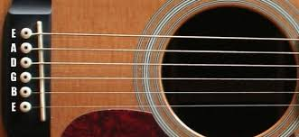
More on Cstring I/O (2)
If the string’s declared size is not large enough to hold the input characters and the added ‘\0’, the extraction operator stores characters into memory beyond the end of the array
Is this a problem?
Another function is required to read whitespaces
See examples cstring1.cpp and cstring2.cpp

Slide 28
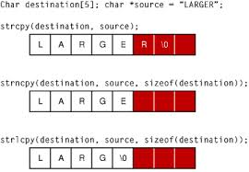
Functions Requiring Cstrings
Some functions require C strings instead of C++ string objects
I/O related functions (open, close, etc.)
See example: cstring3.cpp

Slide 29
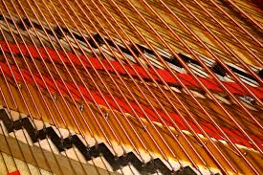
Cstring Library Routines (1)
Functions are needed for the = and == operators
strcpy and strcmp
strlen(string) - returns size_t (unsigned int) the length of a string (not including the \0)
length=strlen(“I am here”) returns 9
strcpy(copy,original) - copies a string - copy must be big enough to hold original - returns the address of copy

Slide 30

Cstring Library Routines (2)
strcat(buffer,string)- concatenates strings - buffer must be big enough to hold buffer and string - the NULL of buffer is overwritten
strcmp(string1, string2) - compares two strings –
returns 0 if string1 is identical to string2
returns a negative value if string1 < string2
returns a positive value if string1 > string2
Runtime errors (memory overwritten) can occur when not enough storage is allocated
See examples cstring4.cpp and cstring5.cpp

Slide 31

Multi-Dimensional Arrays (1)
Two dimensional arrays are related to matrices (board games, computer screen)
A two dimensional array is a collection of components, all of the same type, structured in two dimensions, (referred to as rows and columns)
Individual components are accessed by a pair of indexes representing the component’s position in each dimension
For example:
1 2 3
4 5 6
2 rows and 3 columns
Two-dimensional arrays are simulated by having an array of arrays
This means having an array where each cell in the array is an array

Slide 32
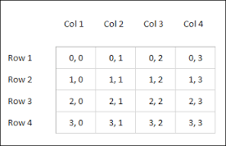
Multi-Dimensional Arrays (2)
Syntax:
DataType ArrayName [ConstIntExpr] [ConstIntExpr] . . . ;
Example:
float twoDim[3][4] ;
C++ stores arrays in row major order
The first row is followed by the second row, etc.
See example: marray1.cpp

Slide 33
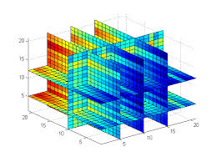
Passing Two Dimensional Arrays
Just as with a one-dimensional array, when a two - (or higher) dimensional array is passed as an argument, the address of the caller’s array is sent to the function
The size of all dimensions except the first must be included in the function heading and prototype
See examples: marray2.cpp and marray3.cpp

Slide 34
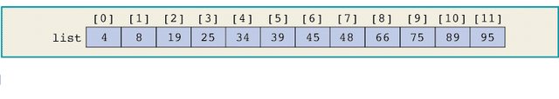
Binary Search
A binary search is similar to a dictionary search
A binary search uses the “divide and conquer” technique to search the list
First, the search item is compared with the middle element of the list.
If the search item is less than the middle element of the list, we restrict the search to the upper half of the list; otherwise, we search the lower half of the list.
Consider the following sorted list of length = 12

Slide 35
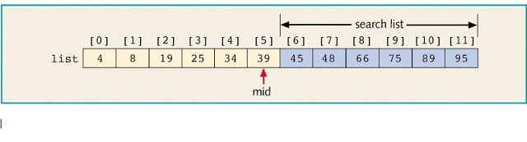
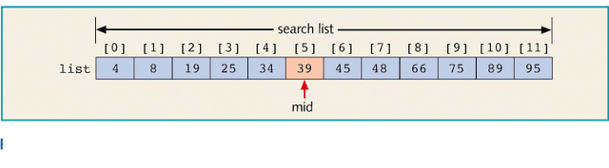
Determine if 75 is in the List
Compare 75 with the middle element in the list, list[5] (which is 39).
Because 75 ≠ list[5] and 75 > list[5], we then restrict our search to the list list[6]...list[11]

Slide 36
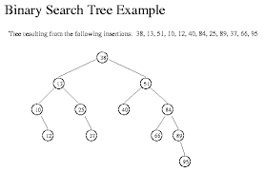
Binary Search Code
int binarySearch(const int list[], int listLength,
int searchItem)
{
int first = 0;
int last = listLength (1);
int mid;
bool found = false;
while(first <= last && !found)
{
mid = (first + last) / 2;
if(list[mid] == searchItem)
found = true;
else
if(list[mid] > searchItem)
last = mid (1);
else
first = mid + 1;
}
if(found)
return mid;
else
return –1;
}//end binarySearch (see example bsearch.cpp)

Slide 37
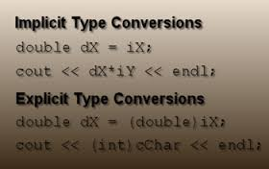
Casting
Without casting C++ performs implicit type coercion
Cast operator
An expression is evaluated and then converted
static_cast<dataTypeName> (expression)
See cast1 example

Slide 38


Casting with enums Example
enum sports {BASKETBALL, FOOTBALL, HOCKEY};
sports popularSport;
popularSport = FOOTBALL; // legal
popularSport++; // is illegal (no arithmetic operation is legal)
popularSport = popularSport +1 ; // is illegal
popularSport=static_cast<sports>(popularSport+1) // changes PopularSport to HOCKEY

Slide 39
C++ Data Types
simple
structured
integral enum
floating
array struct union class
char short int long bool
address
float double long double
pointer reference

Slide 40

Structured Data Types
A structured data type is a type in which each value is a collection of component items
The entire collection has a single name
Each component can be accessed individually
Often related information of various types is store together for convenient access under the same identifier
Arrays, structs, and classes are C++ structured data types

Slide 41
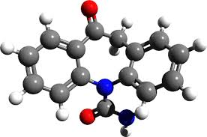
struct type Declaration
SYNTAX
struct TypeName // does not allocate memory
{
MemberList
} ;
MemberList SYNTAX
DataType MemberName ;
DataType MemberName ;

Slide 42
Sample struct
Example
struct AnimalType // declares a struct data type
{ // does not allocate memory
long id ;
string name ;
string species ;
string country ;
int age ;
float weight ;
} ;
AnimalType thisAnimal ; // declares a variable of AnimalType
AnimalType thatAnimal = {123,”Leo”,”lion”,”India”,10,500.0} // initialized values

Slide 43
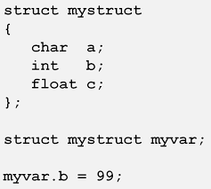
Struct Members
Cannot have type void
Cannot nest a structure of it own type
It can have members that are structures of other types
Member names must be unique within a structure
They do not have to be unique between structure
Members can be arrays, pointers, other structures, etc.

Slide 44

Accessing struct Members
Dot ( period ) is the member selection operator
After the struct type declaration, the various members can be used in your program only when they are preceded by a struct variable name and a dot
EXAMPLES
thisAnimal.weight
anotherAnimal.country

Slide 45
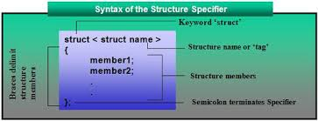
Aggregate Operations on structs (1)
An operation on a data structure as a whole, as opposed to an operation on an individual component of the data structure
Valid operations:
Assignment: thisAnimal=thatAnimal;
Pass an argument: (by value or by reference)
Return as value of a function
Dot operator (thisAnimal.age)

Slide 46

Aggregate Operations on structs (2)
Invalid operations (must be done one member at a time)
I/O
Arithmetic (thisAnimal + thatAnimal;)
Comparisons of entire struct variables (thisAnimal>thatAnimal;)
See example: struct1.cpp

Slide 47
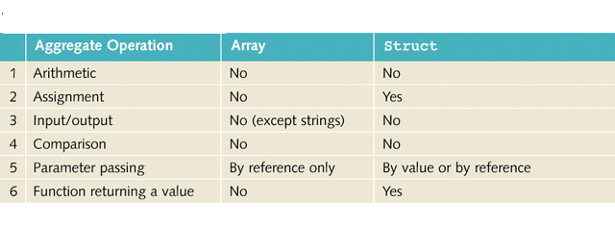
Array vs. Structures

Slide 48
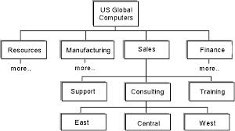
Hierarchical Structures
A member of a struct member can be another struct type
This is called nested or hierarchical structures
Hierarchical structures are very useful when there is much detailed information in each record

Slide 49


Sample Hierarchical structs
Example:
struct time
{
int hour;
int min;
int sec;
} myTime;
struct date
{
int month;
int day;
int year;
time myTime;
} myDate;
See example: struct2.cpp

Slide 50
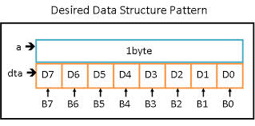

Unions in C++
A union is a struct that holds only one of its members at a time during program execution
EXAMPLE
union WeightType
{
long wtInOunces ;
int wtInPounds; // only one is active at a time
float wtInTons;
} ;

Slide 51

Passing structs
Can be done three ways:
Pass the entire structure (copy)
Pass by reference
Pass by using a pointer
See example: struct3.cpp

Slide 52

Arrays of Structures
Syntax is similar for built in data types (int, floats, etc.)
struct part // specify a structure
{
int modelnumber; // model number of widget
int partnumber; // part number of widget part
int quantityPerBox [2]; // quantity in a box (2 types)
float cost; // cost of part
};
part myPart[10]; // define array of structures
See example: struct4.cpp

Slide 53

Functions within Structures
See example: struct5.cpp

Slide 54

Abstraction
Is the separation of the essential qualities of an object from the details of how it works or is composed
Focuses on what, not how
Recommended for managing large, complex software projects

Slide 55

Data Abstraction
Abstract Data Type (ADT)
Separates the logical properties of a data type from its implementation
LOGICAL PROPERTIES IMPLEMENTATION
What are the possible values? How can this be done in C++?
What operations will be needed? What data types be used?

Slide 56
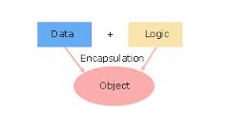
C++ Classes (1)
Classes combine both data and operations into a single cohesive unit (encapsulation)
It is similar to a struct with operations that manipulate the data
Class type variables are called class objects, objects, class instances or instantiations of the class
The components of a class are called members of the class

Slide 57

C++ Classes (2)
Classes are abstract data types (ADTs)
Data abstraction is the separation of a data type’s logical properties from its implementation details
A client of the class is any software that declares and manipulates class objects
Declares class variables
Uses public member functions to manipulate/handle class objects

Slide 58
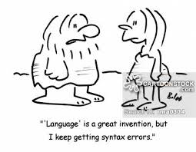
C++ Class Syntax
Syntax:
class className
{
public:
// data elements or member functions
private:
// data elements or member functions
protected:
// data elements or member functions
};
The class declaration creates a data type and names the members of the class
It does not allocate memory for any variables of that type
Client code still needs to declare class variables

Slide 59
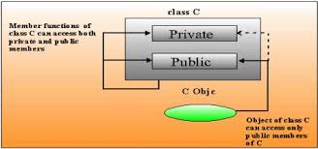
Access Specifiers (1)
Classes are composed of data and functions (methods) members that are public, private, or protected
public members: public interface
Provides the interface between the client code and the class objects
They are the only way a client can access/read/modify private data members
Function members (methods) are generally declared public

Slide 60
Access Specifiers (2)
private members: members are inaccessible to clients
If a client attempts to access a private member, a compilation error will occur
Can be accessed only by the class’s member functions and friend functions
Default
Data members are generally declare private
protected:
Not accessible by client code but are accessible by derived classes
All members in C++ struct are public

Slide 61
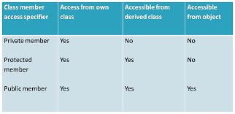
Access Specifiers Summary

Slide 62

C++ Member Functions
Member function syntax:
Return-type className::functionName([parameter-list])
{
body
}
If a function only inspects (not modify) data members, the word “const” should be specified in both the function prototype and the heading of the function definition
Example: void print ()const;
Within the body of a const function, a compilation error occurs if an attempt is made to modify a private data member

Slide 63
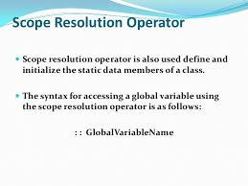
Scope Resolution Operator ( :: )
C++ programs typically use several class types
Different classes can have member functions with the same identifier, like Write( )
Member selection operator is used to determine the class whose member function Write( ) is invoked
currentTime.Write( ) ;
numberZ.Write( ) ;
In the implementation file, the scope resolution operator is used in the heading before the function member’s name to specify its class
void TimeType :: Write ( ) const
{ . . .
}

Slide 64

Specification and Implementation Files
An Abstract Data Type (ADT) consists of specification and implementation files
Specification file
Contains class data members and function prototypes
Resides in a header file (.h)
There are no implementation details
Implementation file
Contains the member function definitions
Resides in a .cpp file
Need to #include the specification file
Client code should reside in a separate .cpp file
Need to #include the specification file
See Style guide for formats
See examples: class1.cpp through class3.cpp

Slide 65
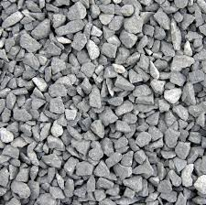
Aggregate Operations on Class Objects
Valid aggregate operations on class objects are the same as the valid operations on structs
Valid operations:
Assignment: object1=object2
Pass an argument: (by value or by reference)
Return as value of a function
Dot operator (object1.print())
All other operators (+ - * / > < etc.) are invalid unless they are defined by the programmer

Slide 66

Functions and Classes
Class objects can be passed as parameters to functions and returned as function values
As parameters to functions, classes can be passed either by value or by reference
If a class object is passed by value, the contents of the data members of the actual parameter are copied into the corresponding data members of the formal parameter
If a variable is passed by reference, then when the formal parameter changes, the actual parameter also changes

Slide 67

Class Constructors (1)
An operation that creates a new instance of a class
A member function whose purpose is to initialize the private data members of a class object
The name of a constructor is the same as the name of the class
Return types are invalid for constructors
Constructors are not invoked with the . operator

Slide 68

Class Constructors (2)
A class may have several constructors with different parameter lists (signatures)
A constructor with no parameters is the default constructor
A constructor is implicitly invoked when a class object is declared
If there are parameters, their values are listed in parentheses in the declaration
Good idea to have a default constructor

Slide 69

Constructor Syntax
Syntax
className([parameter list]);
Particular constructor invoked depending on signature
Sample class specification
class MyTime
{
public :
MyTime ( int initHrs , int initMins , int initSecs ) ;
MyTime ( ) ; // default constructor
...
}

Slide 70

Invoking the Default Constructor
The syntax to invoke the default constructor is:
className classVariableName;
The statement
clockType yourClock;
declares yourClock to be a variable of the type clockType
The default constructor is executed

Slide 71

Invoking a Constructor with Parameters (1)
The syntax to invoke a constructor with parameter is:
className classVariableName(argument1,argument2,. . . );
where argument1, argument2, etc. is either a variable of an expression

Slide 72

Invoking a Constructor with Parameters (2)
The number of arguments and their type should match with the formal parameters (in the order given) of one of the constructors
If the type of the arguments do not match with the formal parameters of any constructor (in the order given), C++ will use type conversion and look for the best match
For example, an integer value might be converted to a floating-point value with zero decimal part
An ambiguity will result in a compile time error

Slide 73

Example Invoking a Constructor with Parameters
For example:
clockType myClock(5,12,40);
This statement declares a class variable myClo
The constructor with parameters of the class clockType will be executed and the three data members of the variable myClock will be set to 5, 12, and 40
See examples: class4.cpp and class5.cpp

Slide 74
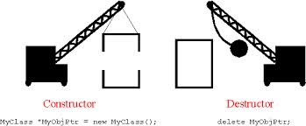
Class Destructors
An operation that destroys an instance of a class
Whenever a class object goes out of scope (for example: control passes to the end of a block), a class destructor is implicitly invoked
Destructors are not invoked with the . operator
A destructor need not always be defined
Depends of the type of the class data members
A class can have only one destructor and it has no parameters

Slide 75

Syntax of Class Destructors
Syntax of the class destructor
~className( );
Sample destructor
class MyTime
{
public :
~myTime( );
...
}

Slide 76

Helper Functions
Helper Functions
Public member functions may need to invoke functions
Clients do not need to access implementation details of a member functions
Private member functions invoked by public member functions

Slide 77
Information Hiding
Class implementation details are hidden from the client’s view
This is called information hiding
Public functions of a class provide the interface between the client code and the class objects
client
code
abstraction
barrier
specification
implementation

Slide 78

Information Hiding (1)
Two different type of programmers
Author of the abstract data types (ADTs) (C++ classes)
Know only what the ADT will do for the client, but nothing about the context in which the ADT will be used by the client

Slide 79

Information Hiding (2)
Clients of the ADT
Know only what the ADT will do, not how the ADT carries out its tasks
Implementation details are hidden from the client’s view
Know how to use the ADT via the application program interface (API)
Number of parameters
Type of parameters
If they are input or output
The purpose of each parameter
Any restrictions on each parameter
The type and purpose of the return value
Only functions needed by a client should be public
Helper functions should be private

Slide 80
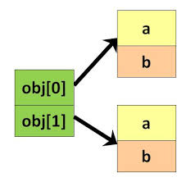
Arrays of Objects
Syntax is similar for built in data types (int, floats, etc.) and structs
TimeType startTime[2]; // array of objects
(See examples: class6.cpp and class7.cpp)

Slide 81

Static Data Members
A static data member is not duplicated for each object
It is shared by all objects of the class
A static variable could be used to keep track of the number of objects for a class
See example: class8.cpp

Slide 82
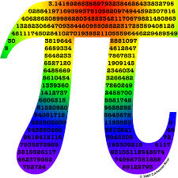
Const Parameter Modifier (1)
The keyword “const” is a promise to the compiler that you won’t write code that changes something
Using “const” is a request that the compiler enforce this promise
Example: const int myInt = 3; // you won’t change myInt

Slide 83
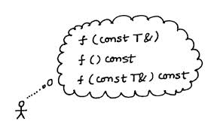
Const Parameter Modifier (2)
If one is using call by reference (call by copy never changes parameters) and one does not want a function to change the value of the parameter, one can use the const modifier
Automatic error checking done at compilation time
Can fool the compiler by indirectly change the variable by using pointers
The const parameter must appear on the function definition if it appears on the prototype
If const is at the end of the prototype and function heading
A function cannot change any passed parameters
A member function cannot change any of the classes data members
See example: class9.cpp and class10.cpp

